Slide 1
HAKK!
A mobile governance App
By
Vishnavi
Sindhu Bhargavi
Varshitha
Bhavya

Slide 2
Abstract
Hakk! is a combination of various services that are provided to the users through a mobile application.
They include
e-Voting system
Public opinion portal
Information about local MLA/MP

Slide 3
e-Voting system
In e-voting system, people can cast their vote online using the mobile application installed in their smartphone. The System verifies if the user has already casted his vote, if not the user is given the permission to cast his vote to the candidate of his/her choice and the system records the UID and EPIC number of the user to prevent casting of multiple votes.

Slide 4
Public opinion portal
In public opinion system, the registered users has the right to express their opinions on the schemes and the policies implemented by the government and the cumulative data would be displayed depicting the voice of the people and giving a clear picture whether the government has the acceptance from the people or not.

Slide 5
Info about local MLA/MP
Apart from these services the user(Guest/Registered) can also know the current MLA/MP of his/her constituency and the Bio-data of the public representative.

Slide 6
HAKK!
Overall the project aims to fulfill the 3 basic rights of every citizen,
1. Right to vote
2.Right for freedom of speech
3. Right to know.
Hence the name of the app “HAKK!”

Slide 7
User authentication Technique
A user ID (EPIC number), UID (Aadhar Number) and password are used as the first level of security. The data entered by the user is verified with the contents of the database, if the data is correct then the user need to enter the answers for the high security questions (entered at the time of registration) in the final level the user need to unlock (decode) a picture password, which the user has set at the time of registration. If the data entered by the user in all the three levels is found valid, he gets access to the voting system.

Slide 8
Existing System
At present elections in India are conducted using the EVMs(Electronic Voting Machines)
The users need to have the information about their polling station.
The users have to stand in a queue for a longer time.
The Indian EVMs are purposely designed as stand-alone units to prevent any intrusion during electronic transmission of results. Instead, the EVMs are collected in counting booths and tallied on the assigned counting day(s) in the presence of polling agents of the candidates.

Slide 9
Advantages
Online voting (e-voting) would be more convenient, relatively secure and utilize fewer resources. To be able to access e-voting system from a handheld device like a smartphone may be more convenient for many people. This could potentially be a solution for the low voter turnout at the polls. Also the users can also know the Bio-data of their MLA/MP.

Slide 10
HARDWARE REQUIREMENTS
Smartphone working on Android platform with a minimum RAM of 512MB and 1 GHz processor with Internet access.
SOFTWARE REQUIREMENTS
Minimum Mobile Operating System requirement: Ice Cream Sandwich.
Android Studio 1.1.0 with Android SDK (Developer side)
Java SE Development Kit 8 (Developer side)
Cloud Storage

Slide 11
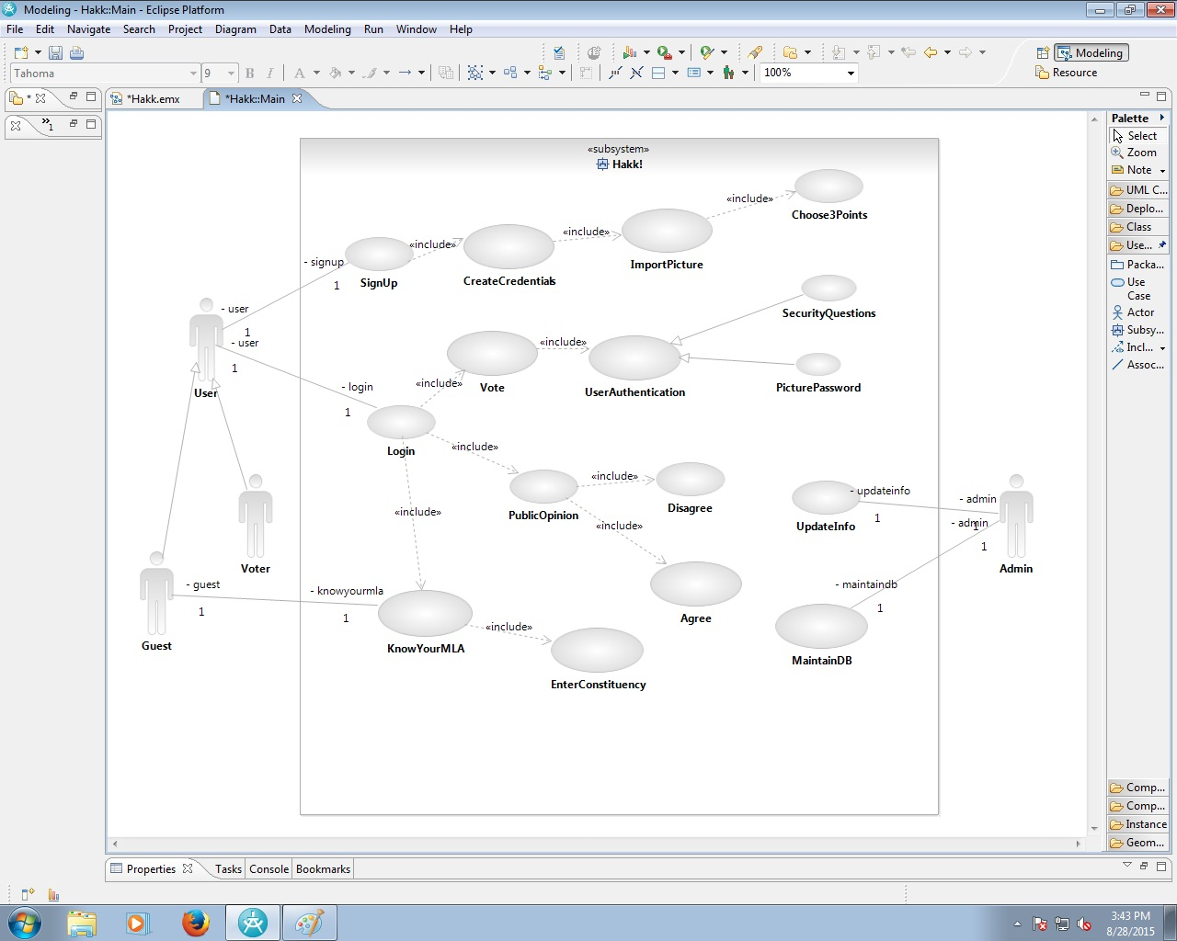
Use case diagram:

Slide 12
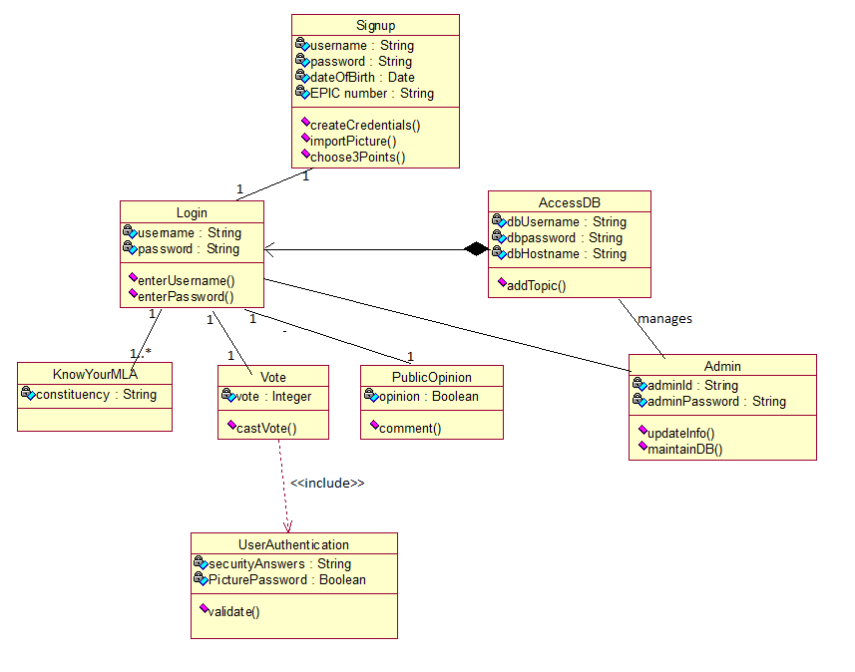
Class diagram:

Slide 13
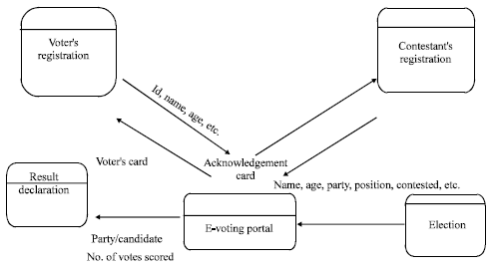
Data flow diagram:

Slide 14
Disadvantages:
People are very least aware of the things going on in the politics in the current busy world.
Voting at polling stations is very length process and requires a lot of patience.
Voters are not known about the candidates that are contesting in the elections

Slide 15
Proposed system:
We propose the following research question: is there an application which would act as a one-stop-shop for all that you need to know about politics or current issues, the solution is No. We would like to establish one such system that would serve the purpose of every Citizen of this country

Slide 16
THANK YOU!!
By
Vishnavi
Sindhu Bhargavi
Varshitha
Bhavya

